Slide 1
Book chat app Book-rack - By ritesh singh
Welcome to our digital haven for all things bookish! Explore a treasure trove of literature, engage in lively conversations, and unearth your next literary obsession. Join our vibrant community of readers and let the pages come alive

Slide 2
introduction
The idea behind this project is to create a site for book lovers to discuss their favorite books.
We know there is nothing a reader would love more than to discuss his/her reads.
The best to recommend a book is through its quotes, hence our sites provides a dedicate place to share and discuss the best lines a book has to offer.
With google books API, you can search all the book you want through our site.

Slide 3
Components
Navbar: * uses reach-router-dom to navigate to different components
ChatBox: * container component for chat application and room selection * has form which redirects to chat interface
Chat : * has Messages, SendMessages and userAndRoom components * Uses socket.io client to communicate with backend
Comments: * standalone component that renders entered text as comments on the page
Contact: * implements react forms to get suggestion from user

Slide 4
Node mODULES
EXPRESS:
CORS:
SOCKET:
MONGOOSE: Mongoose is a mongoDB object modeling includes features like validation , type casting and Query building.
HTTP: module in node.js can be used to create on HTTP server that listens for incoming request originating from local host .

Slide 5
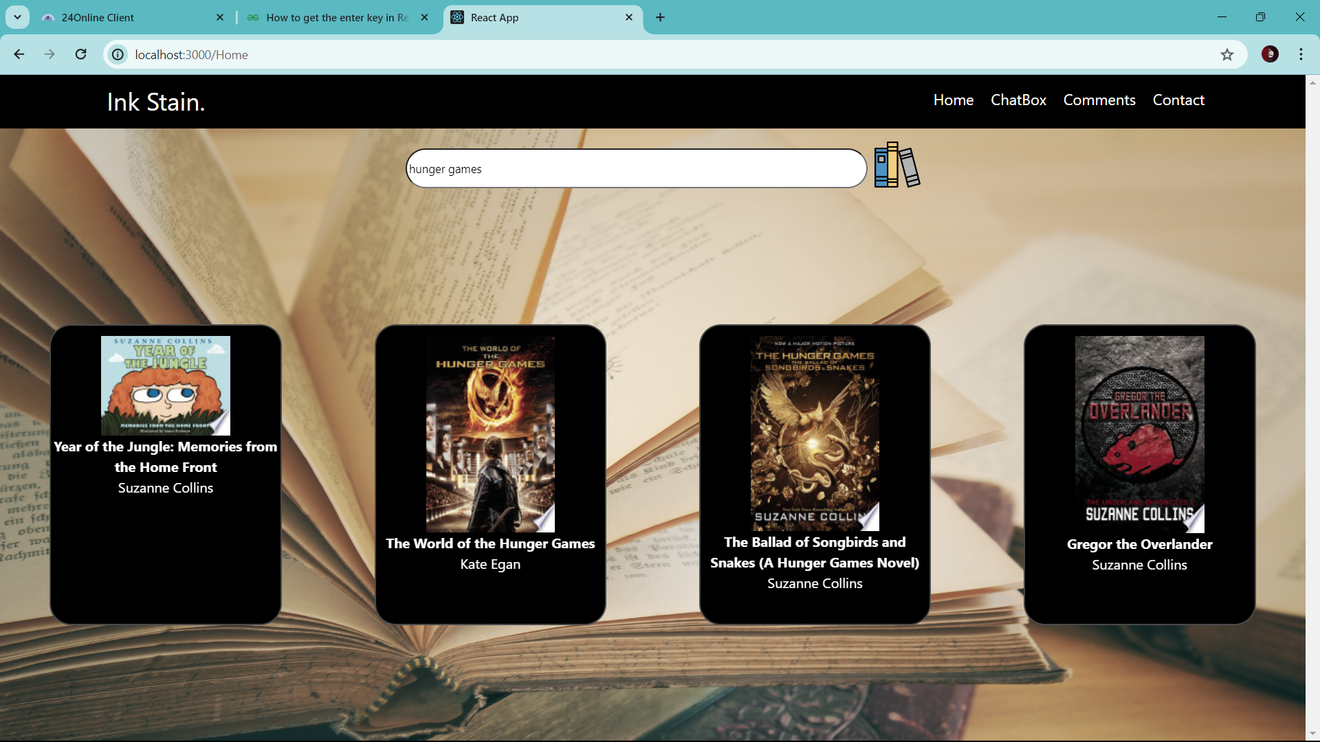
Search your Favorite books

Slide 6
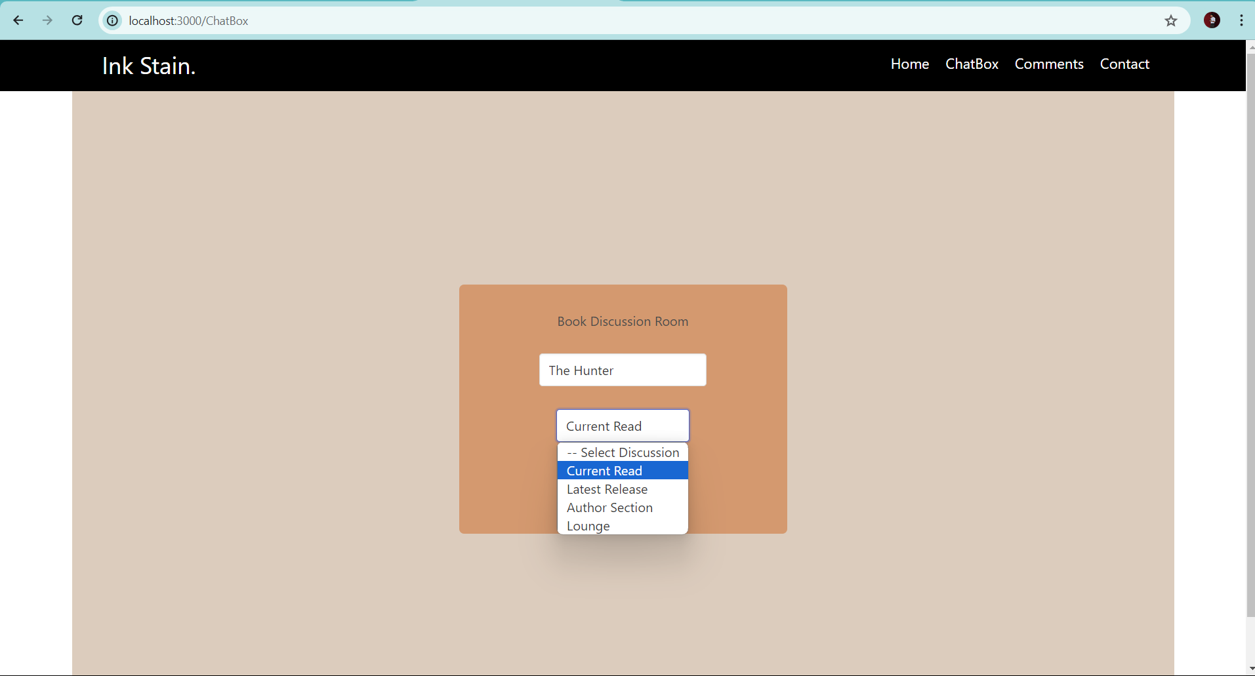
Join dedicated room to discuss

Slide 7
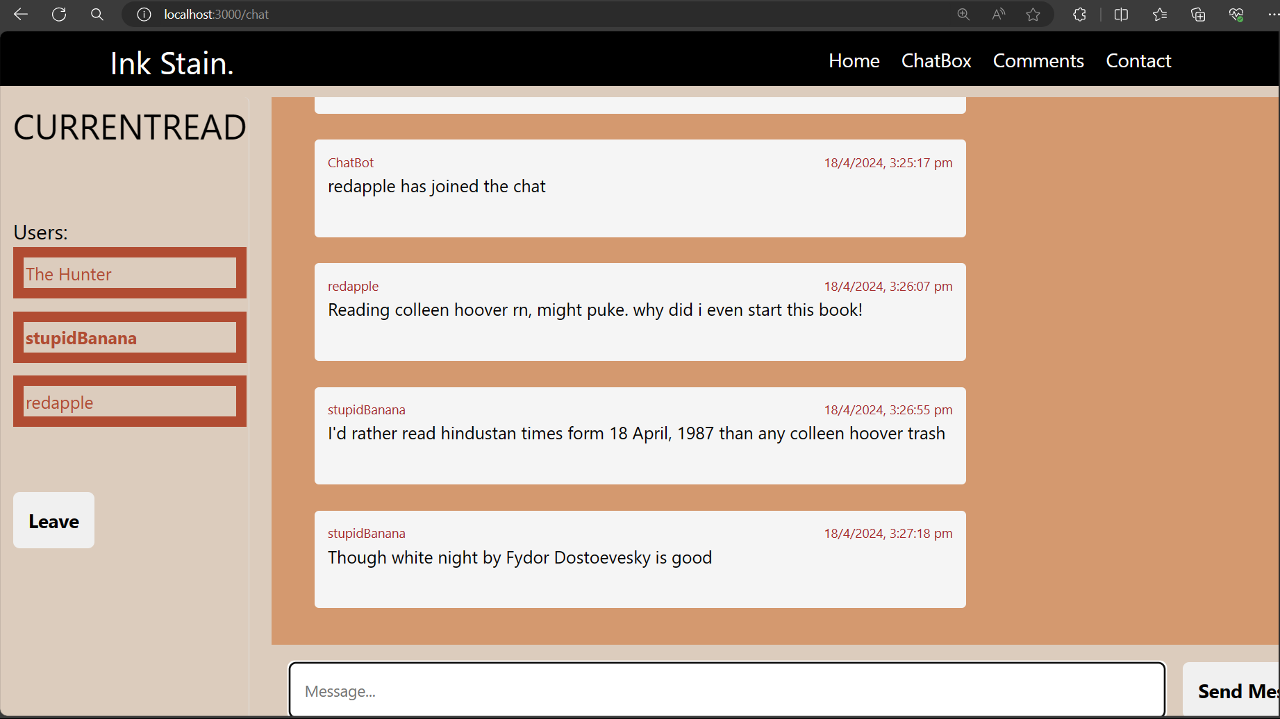
Discuss your current read

Slide 8
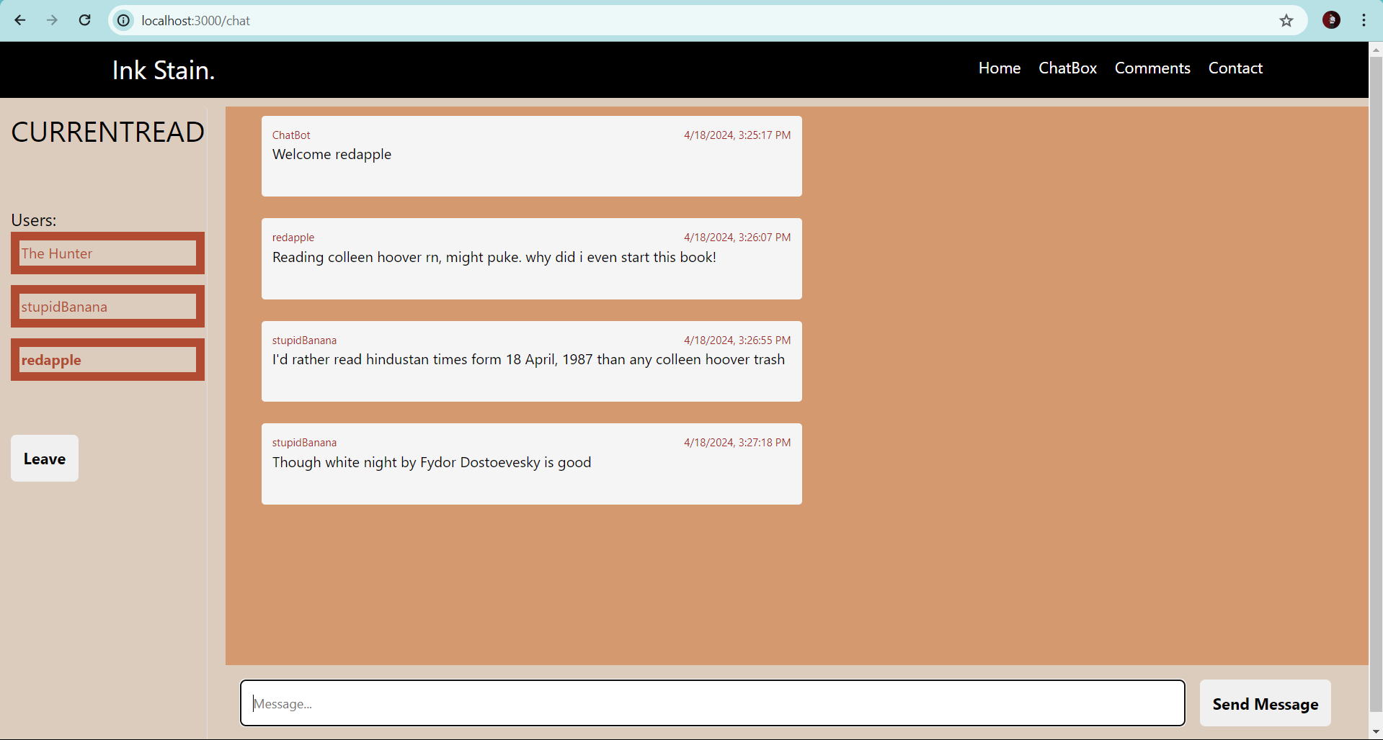
Chat in real time

Slide 9
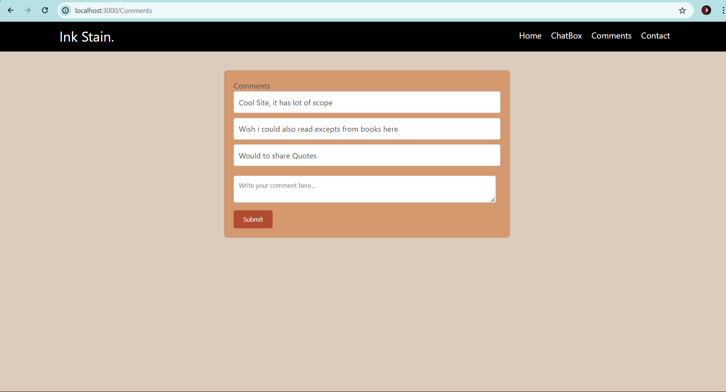
Share anonymous comments

Slide 10
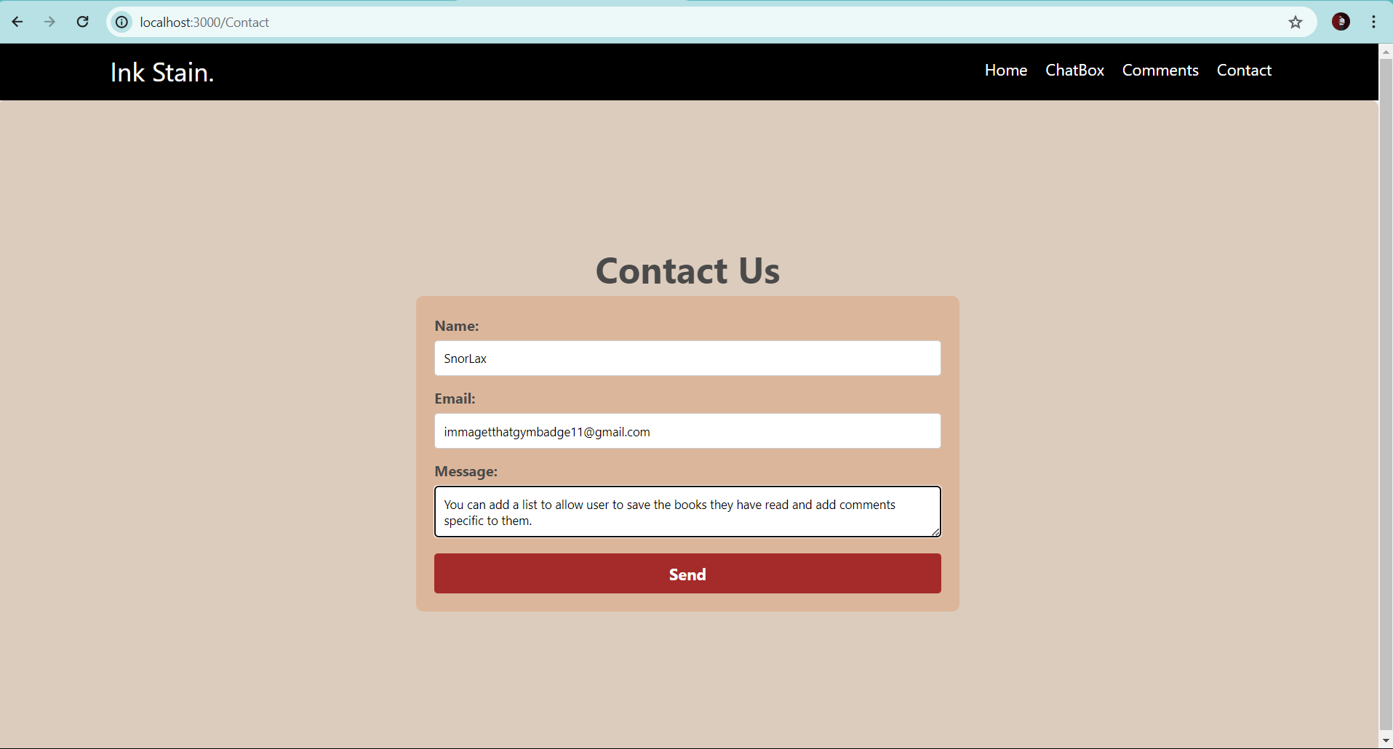
Send suggestion, see the change you want

Slide 11
Future scope
Full fledged social: The book can be made into objects each with its own set of quotes and discussion
User Profile: User profiles can be added to track the books they’ve read and liked.
Author Space: Budding authors can post articles to showcase their writing, get inspiration and have productive discussions

Slide 12
Thank You

